Slide 1
DISUSED SOURCE WORKING GROUP SURVEY ON LICENSEE PARTICIPATION IN A POTENTIAL SECURE EXCHANGE PROGRAM FOR DISUSED SEALED SOURCES
Prepared by A. Cecilia Snyder
LLW Forum Communications Consultant
June 30, 2019

Slide 2
Background
While disposal access is now available for most disused sealed sources (sources no longer needed), many sources are not being disposed due to high disposal costs. One potential alternative is reuse/recycle. The Disused Source Working Group (DSWG) of the Low-Level Radioactive Waste Forum (LLW Forum) is considering the possibility to create a Secure Disused Source Exchange Program that would allow radioactive materials licensees to list their unwanted sources safely, on a secure website, which other licensees in need of a sealed source could access.
The Exchange would work with licensees, source and device manufacturers, and recyclers to provide them with information about sources still having a useful life, with the goal of increasing beneficial reuse and recycle opportunities. The website would contain the complete pedigree of each source, while maintaining the confidentiality of each source licensee. The purpose of this survey, therefore, is to solicit feedback and input on this potential secure exchange program.

Slide 3
Response Volume (total as of 6/30/19 = 264)

Slide 4
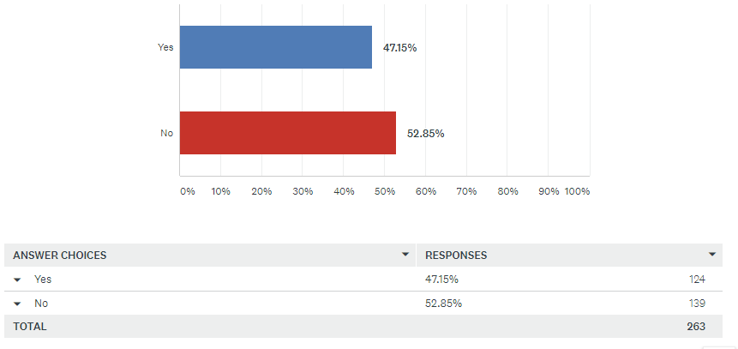
Q1: Do you have sealed sources in storage?

Slide 5
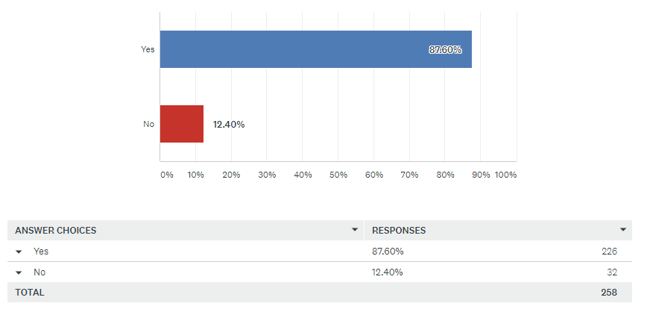
Q2: Would you consider registering your disused sealed source in a secure sealed source exchange program (similar to the program previously overseen by the Conference of Radiation Control Program Directors)?

Slide 6
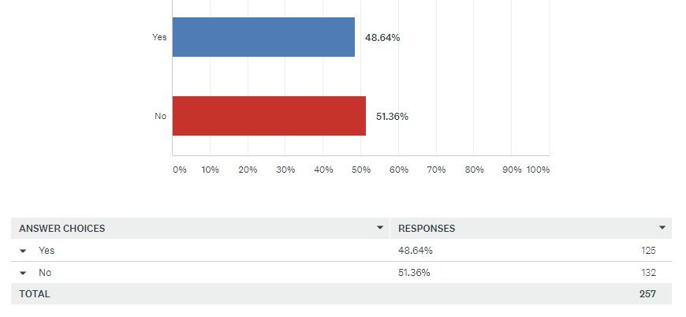
Q3: Do you have more than one source that you would register?

Slide 7
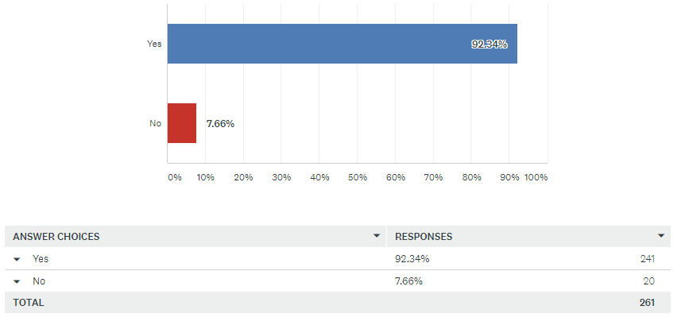
Q4: Do you think a secure sealed source program would be beneficial?

Slide 8
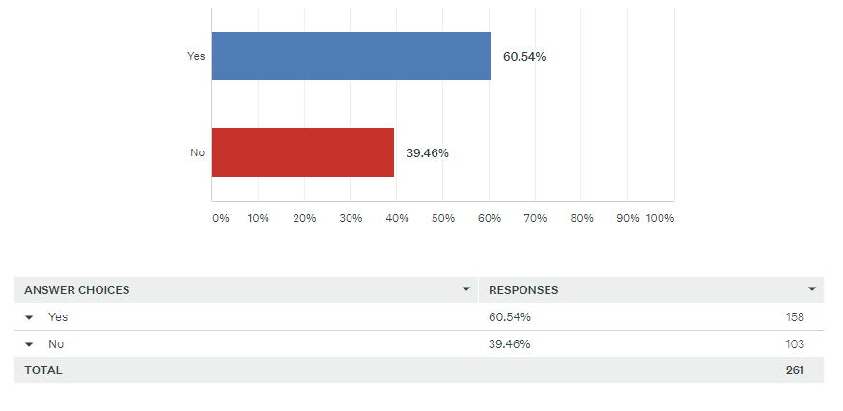
Q5: Would you use such a program to obtain sealed sources?

Slide 9
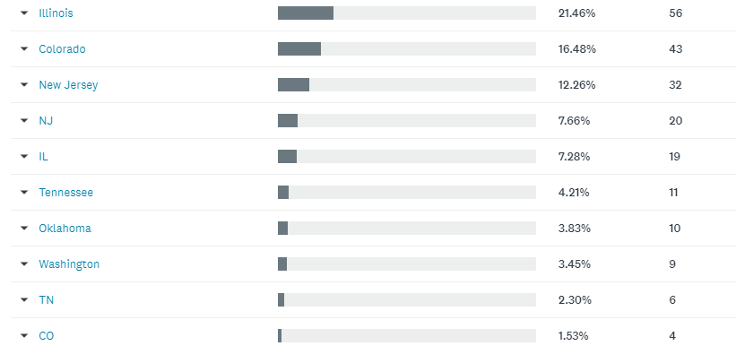
Q6: Please enter your state.

Slide 10
Q7: Describe what would encourage you to participate in a secure source exchange program. (225 responses)
The cost savings of using a source that still has a viable life versus purchasing a new source.
Low or no cost, secure way of finding a home for sources not useful to me but to someone else without the costs.
Regulatory cooperation, low costs
Safely dispose of sources
There would have to be an appropriate chain-of-custody type paper trail to ensure that any exchange does not later become a company liability, especially with any government agency.
Easier and faster
Alternative disposal method
we have a general license and this would allow us to transfer unused ECDs between facilities.
Confidentiality
Ease of obtaining a sealed source.
If the program was simple, No cost associated.
source needed for new project.
Reduced cost, warranted equipment, maintenance agreements
If the quality was good and the pricing was advantageous.
High disposal fees. Security.
Less cost than disposal, recycling better than disposal
Secure site, control of the information in regards to clients. Would prefer a company number rather than using company name to maintain confidentiality.
Cost and recycling
the old sources sit in storage in our hot lab for years just taking up space. Its costly to have them removed.
low cost to transfer source
We have no need for long lived sources
Ease of program, and also not too much paperwork/documentation.

Slide 11
Q7: Describe what would encourage you to participate in a secure source exchange program. (continued)
The ease of getting rid of them and knowing that it could be used elsewhere.
The facility accepting the source needs to accept the liability for the life of the source.
If a gauge needed to be purchased, or if we needed to get rid of one.
cost and potential liability. we would not purchase used sources unless the OEM provides guarantees and will service the equipment.
Ease of removing old sources from current inventory
it seems like a simple opportunity. I doubt quantities of concern would be listed. Ensure security of the site would be very important.
We don't have sealed sources so this survey is not applicable to us. We only generate radioactive materials as a by-product.
High disposal costs
Lower costs and the reuse concept as opposed to disposal
The ability to have secure place to dispose of unused sources
Cost
It would reduce the amount of radioactive sources we have in storage at our facility
Hate to dispose of something others could use
A program in place
Recycle and connect with community
Would be a nice alternative to disposal of old nuclear dosimeters.
No to low cost.
Method of disposal with out incurring fees to device manufacturer
The cost of disposing of sources
minimum cost

Slide 12
Q7: Describe what would encourage you to participate in a secure source exchange program. (continued)
helping the environment
Protecting the environment
Chance to obtain expensive or difficult to obtain isotopes
easy access and transport
If it was cost effective and not a ton of paperwork.
Ease of exchange; easier exchange will result in more likely participation
No cost
Less or no cost to dispose of old sources. Availability to cheaper sources for use in calibrations.
We are a well known manufacturer. People contact us directly when they want to recycle their sources.
Simple descriptions of the sources.
It wouldn't. Reusing sources intended for medical use could create a vast number of regulatory issues.
Reduction in disposal costs
Ability to acquire and offer unwanted sealed sources.
Good Service.
Ability to transfer unused sealed sources to someone who could use them rather than send them for disposal.
Reducing waste and cost of unwanted source disposal
the ability to recycle
Nothing that I can think of right now.
Low cost sources
Cost and Recycling useful sources
none
Not having to send sources back
We have been providing this "recycling process" since 1986 and the biggest stumbling block has been a clear understanding of the concept by licensing departments within the authority agency. Reduce the regulatory delay and I'm certain it will work well. Even with the delay we have been able to make such exchanges work well, just not a quickly as we would like to have the recycled source device authorized to the new owner.

Slide 13
Q7: Describe what would encourage you to participate in a secure source exchange program. (continued)
High cost of disposal of depleted point sources. Approximately 500 dollars per source. If our company could dispose of multiple Ge68 sources at a lower cost it would be very helpful.
Ease of transfer. Less paperwork. Lower cost.
If I could find a sealed source that would suit our needs and would be relatively easy to obtain without a lot of additional work.
Safe program
Ease of getting rid of an unused source.
we have a lot of sources for our equipment and our inventory of equipment changes so holding on to old sources is not preferred and disposal is very expensive.
Helping my customers dispose of or acquire sealed sources for their devices
I think what would encourage us is, would there be a cost savings to purchase a source that would meet our needs when our source is ready for a change-out.
This would allow a lower costs as opposed to disposal
Lower Costs
It is better for the environment.
Recycling of existing out of use/date sources
EXPLANTION ON HOW THIS PROGRAM WOULD WORK, LICENSE CHANGES AS NEEDED WOULD BE A CONCERN
Ability to expedite site de-commissioning process
Save money, better for the environment.
Reduction of wasted sources, lower acquiring costs
disposal cost
To save money on source return cost.
Ability to decrease cost associated with source disposal .
Not only for environmental reasons, but also financial. Possibly receiving an additional source at a much lower cost. Great idea.
A vendor network to install and calibrate older used sources
Everything going to be on the record and it is safe.

Slide 14
Q7: Describe what would encourage you to participate in a secure source exchange program. (continued)
Low cost and not complicated.
The availability of special sources
Source somebody can use rather than being destroyed. Saves precious budget dollars.
Easy to use. Easy to transport sources or someone comes and gets them.
Alternative to high disposal cost and beneficial re-use of a still useful source.
SOURCE WE HAVE ARE USEFUL BUT WE DO NOT NEED THEM
I would be concerned about knowing if the sources are within the recommended working life identified in the Sealed Source and Device Registry Sheet. Also, how do I know if such sources have been exposed to environmental conditions exceeding the Conditions of Normal Use also listed in the Sealed Source and Device Registry Sheet.
general support of combine programs considered
general support of combine programs considered
Information
recycling and cost
Putting unwanted sources to use rather than burying them.
safety
Lower Cost and best use of resources
If we take the time to register them, how many people really want them?
I would find two aspects useful: 1 - removing disused sources from my own inventory 2 - finding usable sources for low cost instead of buying new sources
Sources likely wouldn't be large enough for our use.
Elimination of liability and risk associated with unused sealed sources to the business.
When our density gauge no longer function we would likely avail ourselves of this program.

Slide 15
Q7: Describe what would encourage you to participate in a secure source exchange program. (continued)
Could possibly be less costly to resale the sealed source rather than legally dispose of source.
Ability to move sources out and to get new sources.
Alternative to cost of disposing useful sources
We have several source that have been removed that could be used by someone. The sources are currently being stored.
Having an option other than storing a disused source.
Cost of obtaining new equipment vs program equip.
if we were to have a permanent office in Ill.
The opportunity to dispose of older equipment without the cost of the higher disposal fees.
Being able to save money by passing shipping costs on to someone who could use the low curie source we would normally pay to dispose of
Turnaround time and cost
Hopewell Designs, Inc. is a manufacturer of irradiator systems for calibration of instruments and irradiation of dosimetry. We are always looking for used Cs-137 sealed sources to recycle into our irradiators.
Making it easy with minimum hassle.
Availability of sources I could use
Need
Cost benefits
Simple, safe and secure
Anything to lower outrageous disposal costs
Not in the budget or mission of the program. The licensee should budget for disposal
Low cost
Have many sources to get rid
Affordability
The ability to reduce disposal costs.
Easier ability to get rid of unwanted sources.

Slide 16
Q7: Describe what would encourage you to participate in a secure source exchange program. (continued)
Rather than obtain a source through the exchange program, I would like it to be like a lending library, where I could use the source for a defined period of time, and then return it for safe-keeping.
Recycling is always a good idea and having support from inspectors as an approved method of disposal would be fantastic.
Simplicity in use. Low cost.
Assistance in streamlining the transfer process
We currently trade in old devices for new ones, do not dispose of sources
Looking to dispose of several sources that have not been in use.
Cost savings, trackability of sources, safety
currently the cost of disposal has been the main obstacle in eliminating sources that are no longer being used.
Cost savings.
Cheaper disposal for unused sources
High cost of source disposal.
Low/no cost sources
I like the idea of recycling rather than disposing. I think it would benefit everyone.
To dispose of a source that is no longer in use.
Cutting cost to dispose of them and buying them.
information on how the program would work and any information on the anticipated time to process and moving sources.
Regulatory compliance of participants
Would only use to dispose of unwanted sources
Being able to get rid of sources without having to pay
Reduced paperwork compared to disposal.
Reusing the source instead of paying for disposal.
Integrity and security of the handling and transport. External survey prior to handling out.
The cost of returning the old source.

Slide 17
Q7: Describe what would encourage you to participate in a secure source exchange program. (continued)
Ease of use
Lower Cost's and Reputable Customers
Nothing really. the company we order from has a one for one disposal for sources ordered from them.
not have to pay for shipping fees
If the disused sealed sources available had up to date leak tests completed if required.
Saves money and keeps licensees from disposing of sources that may be beneficial to others.
The high cost to dispose of source(s) and if the source is still has a useful life why dispose of it if someone could use it.
Low cost for recycling vs. disposal
Cost of sources, costs for prep, transportation, installation
we have several sources we no longer need.
none needed. I think it is a great idea.
Cost for disposal is outrageous
Ease of use and if the source I'm looking for is available
low cost, easy access with minimal paperwork
Cost and minimizing the number of sources.
I would actively use this registry to see if sources I need can be acquired. I strongly believe in rehoming disused sources in place of disposal.
Simple process. Low cost. Condition of sealed source capsule.
The purchase or sale of a used or unneeded moisture density gauge.
Recycling is better than buying and disposing. Also the cost may be lower than buying new sources.
It seems it would be cheaper
Save money on buying new sources.
Availability of such a resource.
Access to shipping containers
Effective way to get rid of sources we no longer need without paying a disposal fee

Slide 18
Q7: Describe what would encourage you to participate in a secure source exchange program. (continued)
Cost, and if it was made easy to do.
It would be useful to get rid of old machines
Easy disposition and acquisition
Reduced costs
Cost of disposal
Something positive to do with used equipment.
would most likely be more cost effective
Free sources, free or limited cost transfer of unused materials, less waste is waste sites.
Cost vs, disposal through the manufacturer.
my company tries to recycle as much as possible and with the high cost of source disposal, this program would have multiple benefits.
If there was a source I could use and the cost was significantly lower that a new one.
Economy and common sense.
Cost
I would be encouraged if it were not complicated or did not require significant time to use.
RECYCLE SOURCES TO THOSE THAT COULD USE THEM.
Good value and ease of use.
Ease of Use with little regulatory form/requests/etc.
The ability to remove sources from our campus where disposal costs are too high
Knowledge of available sources and the opportunity to get rid of or obtain sources at reduced costs
The exchange should be easy to accomplish
The cost savings
It might prove more cost effective to get rid of an older source than the traditional ways.

Slide 19
Q8: Add any additional comments here. (87 responses)
We don't have any disused sealed sources at our facility, however, we would find this program beneficial, if / when we might have them in the future.
Great idea, glad to be out of the dark ages
eventually source owners will be back to 'square one' when exchanged sources are no longer usable and disposal costs even higher. maybe consider regulatory changes to allow for store for decay for <300 day half-life.
I would use the program to purchase sealed sources, in the future, depending on price.
Experience with source removal programs has shown them to be difficult, often long wait times and high cost. If sources are not NIST traceable, they would be of little use. It would be worth polling the src suppliers (E&Z or RadCal) to determine who is buying srcs and what type.
On the other hand, to maintain a secure website is challenging these days. It would create a huge problem by cyber attacks.
We don't typically use high activity sealed sources, but would be interested in obtaining orphaned or unwanted liquid or solid sources.
We are a source manufacturer. We are experts in delivering new sources, and offering recycling and disposal services to our customers. I am concerned that two users in this program who agree to move sources between them, will not have the technical, regulatory or logistics expertise to do so.
Would the sealed sources be on loan or permanent transfer? Would there be any background checks or would the RAM license suffice? What would be the expected licensees costs?

Slide 20
Q8: Add any additional comments here. (continued)
Would need assurance that the transfer of sources would also include permanent transfer of liability. If the recipient were to declare bankruptcy I would not like the recipient's regulatory agency or EPA to come back to my company to pay for proper disposal.
I would be willing to work on such a program to assist both the current owner as well as the prospective new owner under our current license authority. R. M. Wester and Associates, Inc.
I welcome the opportunity for such a repository of sources.
Good idea.
I have a lot of customers wanting to dispose of source also some that may have a need to acquire them.
I work at a state agency. I think if we could we'd consider the program. The answers were yes/no, no maybe's, so I answered conservatively. I think this is a good idea.
Would this program allow for the swapping out of sources into other source housings and detectors?
THIS IS MAKING POSITIVE HEADWAY ON A DECAY ISSUE
I strongly believe this idea will be accepted well not only for environmental reasons, but also as a cost effective way to purchase and store sources. Thanks again for the idea and hopefully starting the plan soon.
Some vendors may not be on board with installing older gauges. Their primary business is to sell new sources.
We previously listed sources in a DOE registry, but have not heard more about it for some time.
This sounds to be a significant benefit to the country.
Interesting concept. Would be great if it came to fruition.
Our Nuclear medicine Flood and Dose calibrator sealed sources are depleted meaning they may not be useful to some one else

Slide 21
Q8: Add any additional comments here. (continued)
Let's keep the annual licensing fees low enough so useful gauges are kept in service. Expensive licensing only tempts one to retire a fully functioning device.
The quicker...the better.
Although I have no sources needing disposal at this time. This program sounds like a great idea rather than disposal of useful sources.
Great Idea!
Contact Information: Chris Vanderpool, Radiation Safety Officer, Hopewell Designs, Inc. Email: chris.vanderpool@hopewelldesigns.com Phone: 770-667-5770 (office); 706-338-1036 (mobile)
Most of my source are too close to end of useful life to bother with listing them on this site
excellent initiative. Like the "circular economy" paradigm, this program keeps sources available for their intended use and does not discard them prematurely.
I think this is an outstanding idea!
I have a need for a variety of gamma sources for teaching. I do not have a need for a particular source. It would be nice for the program to make it possible for me to see what sources are available.
Concerns about my institution's liability for mishandling/misuse/improper disposal if I send a source to another institution - cradle to grave.
Like the idea.
At this time we usually trade our older sources in on newer gauges. This service would definitely be of interest if we were reducing our inventory of gauges or stopping gauge use altogether.
Would there be an identified courier to transport sealed sources? Site to site transport may only be cost effective within the State level, but interstate transfer may need NRC or States to work together
Great idea and I would certainly use it.

Slide 22
Q8: Add any additional comments here. (continued)
Seems like a good idea, but I suspect the costs mentioned above will render it not particularly cost-effective in the end.
Hopefully we continue to progress down this avenue. Good idea!
I recommend development.
I would be concerned about the security of the list and the broad availability of it to be accessed. We need to be more vigilant around information we keep on the web even is “secure” locations.
Have tried to use the DOE program in the past to obtain smaller sources but it was difficult to use and cumbersome.
It may be limited by state disposal regulations.
Some sources like floods are very very decayed and there should be a way to toss them out as decayed more than 10 half-lives.
I THINK IT'S A GREAT IDEA. IT'S UNLIKELY I WOULD OBTAIN SOURCES, BUT POSSIBLE.
I anticipate this helping with long-lived (cesium-137, etc) sources, but not with shorter half-life material like cobalt-57
I think this is a great idea.
We have Cf252, which requires special treatment
We have had 2 troxler gauges that were not functional and had not been used in over 10 years that were still stored here because the cost of disposal was prohibitive. We finally returned them to Troxler last fall. Would love to have a less expensive alternative for future disposal
Thanks... -Greg permission to contact: Greg Peterschmidt RSO @ Erwin ResinSolutions , LLC 151 T.C. Runnion Rd. Erwin, TN 37650 Work:(423) 722-1979, Mobile:(803) 450-0843 gapeterschmidt@energysolutions.com www.energysolutions.com

Slide 23
Q8: Add any additional comments here. (continued)
I believe a program such as this could be beneficial and provide an excellent opportunity to control costs.
Think this may be a good idea
Too many unknowns. Knowledge of locations of disused sources should not be available to anyone.
Bryan Mason - Boeing - Health Physicist - 206-518-0962
There have been times when I could use a list of sources that are available. Re-use is better than disposal.
INADEQUATE INFORMATION TO MAKE INFORMED DECISION
Cobalt 60 industrial radiography sources are what would cost us to dispose of but they would be less than 15 curies

