Slide 1
DISUSED SOURCE WORKING GROUP SURVEY ON LICENSEE PARTICIPATION IN A POTENTIAL SECURE EXCHANGE PROGRAM FOR DISUSED SEALED SOURCES
DSWG Meeting
April 18-19, 2019
Alexandria, VA

Slide 2
Background
While disposal access is now available for most disused sealed sources (sources no longer needed), many sources are not being disposed due to high disposal costs. One potential alternative is reuse/recycle. The Disused Source Working Group (DSWG) of the Low-Level Radioactive Waste Forum (LLW Forum) is considering the possibility to create a Secure Disused Source Exchange Program that would allow radioactive materials licensees to list their unwanted sources safely, on a secure website, which other licensees in need of a sealed source could access.
The Exchange would work with licensees, source and device manufacturers, and recyclers to provide them with information about sources still having a useful life, with the goal of increasing beneficial reuse and recycle opportunities. The website would contain the complete pedigree of each source, while maintaining the confidentiality of each source licensee. The purpose of this survey, therefore, is to solicit feedback and input on this potential secure exchange program.

Slide 3
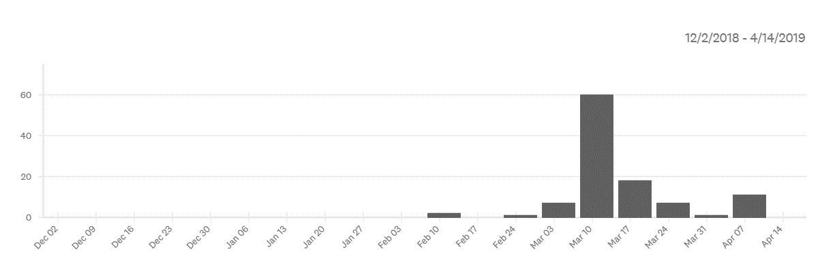
Response Volume (total as of 4/14/19 = 107)

Slide 4
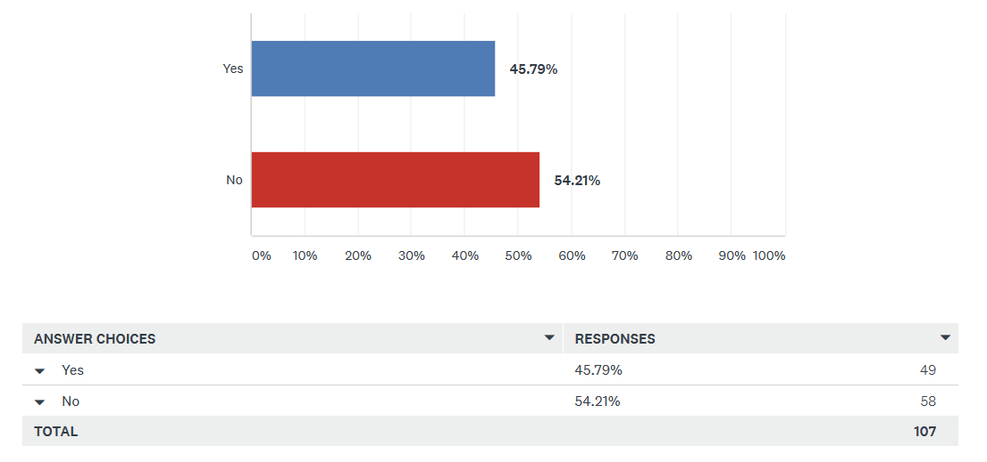
Q1: Do you have sealed sources in storage?

Slide 5
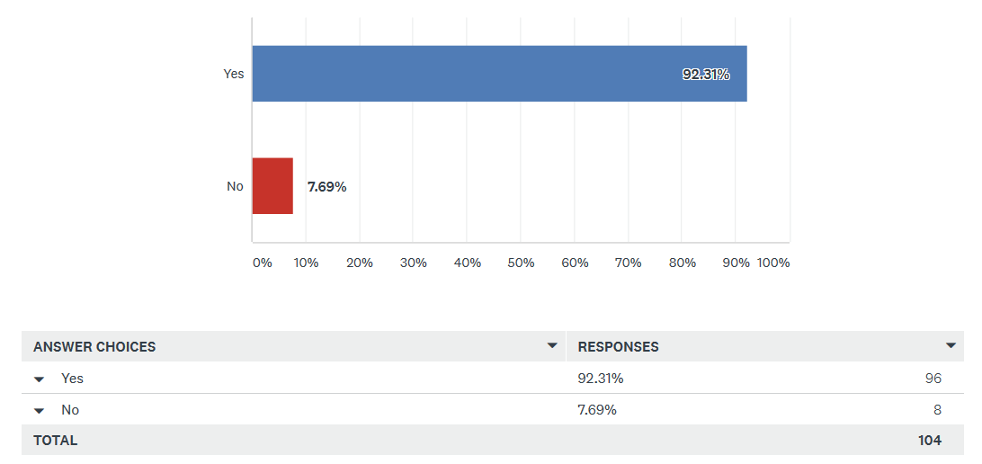
Q2: Would you consider registering your disused sealed source in a secure sealed source exchange program (similar to the program previously overseen by the Conference of Radiation Control Program Directors)?

Slide 6
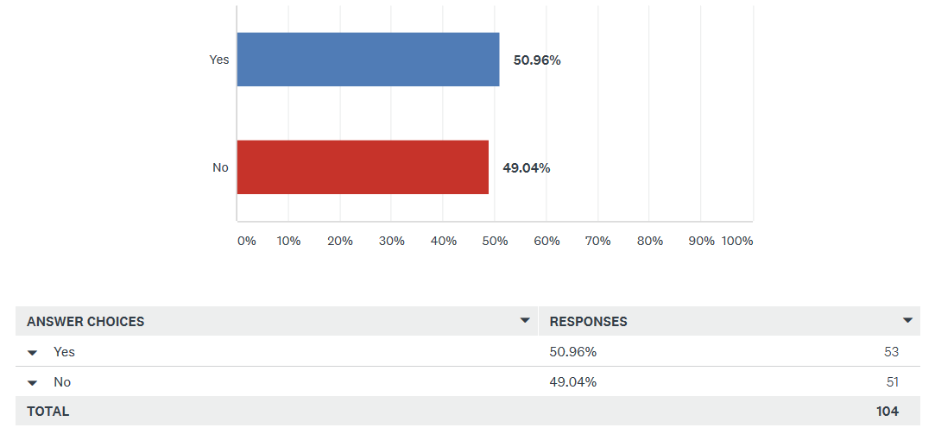
Q3: Do you have more than one source that you would register?

Slide 7
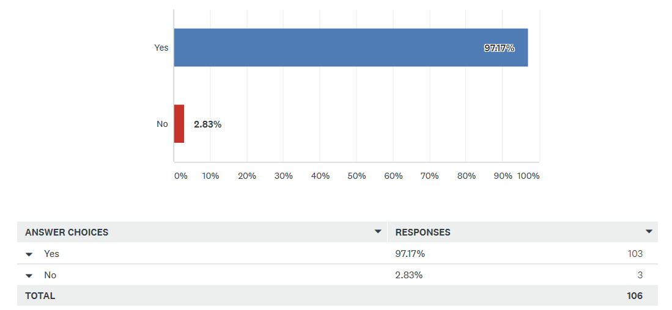
Q4: Do you think a secure sealed source program would be beneficial?

Slide 8
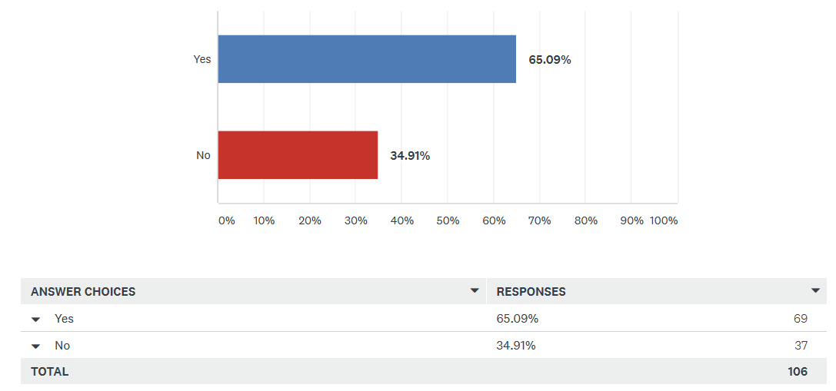
Q5: Would you use such a program to obtain sealed sources?

Slide 9
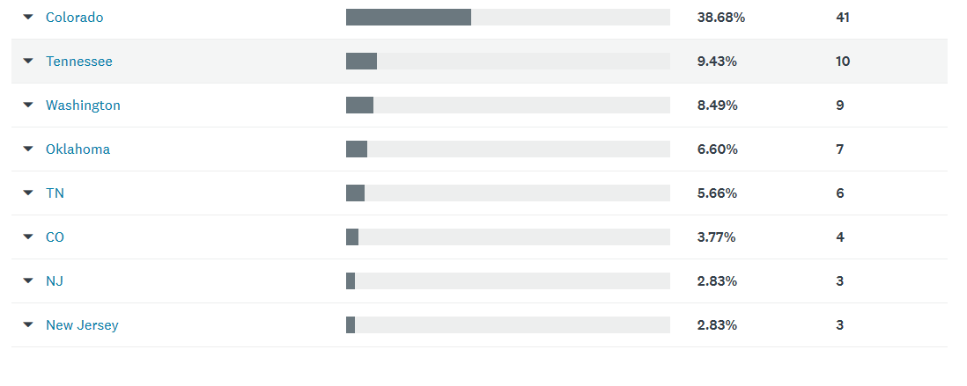
Q6: Please enter your state.

Slide 10
Q7: Describe what would encourage you to participate in a secure source exchange program. (90 responses)
Rather than obtain a source through the exchange program, I would like it to be like a lending library, where I could use the source for a defined period of time, and then return it for safe-keeping.
Recycling is always a good idea and having support from inspectors as an approved method of disposal would be fantastic.
Simplicity in use. Low cost.
Assistance in streamlining the transfer process
We currently trade in old devices for new ones, do not dispose of sources
Looking to dispose of several sources that have not been in use.
Cost savings, trackability of sources, safety
currently the cost of disposal has been the main obstacle in eliminating sources that are no longer being used.
Cost Savings.
Cheaper disposal for unused sources
High cost of source disposal.
Low/no cost sources
I like the idea of recycling rather than disposing. I think it would benefit everyone.
To dispose of a source that is no longer in use.
Cutting cost to dispose of them and buying them.
information on how the program would work and any information on the anticipated time to process and moving sources.
Regulatory compliance of participants
Would only use to dispose of unwanted sources
Being able to get rid of sources without having to pay
Reduced paperwork compared to disposal.
Reusing the source instead of paying for disposal.
Integrity and security of the handling and transport.

Slide 11
Q7: Describe what would encourage you to participate in a secure source exchange program. (continued)
The cost of returning the old source.
Ease of use
Lower Cost's and Reputable Customers
Nothing really. the company we order from has a one for one disposal for sources ordered from them.
not have to pay for shipping fees
If the disused sealed sources available had up to date leak tests completed if required.
Saves money and keeps licensees from disposing of sources that may be beneficial to others.
The high cost to dispose of source(s) and if the source is still has a useful life why dispose of it if someone could use it.
Low cost for recycling vs. disposal
Cost of sources, costs for prep, transportation, installation
we have several sources we no longer need.
none needed. I think it is a great idea.
Cost for disposal is outrageous
Ease of use and if the source I'm looking for is available
low cost, easy access with minimal paperwork
Cost and minimizing the number of sources.
I would actively use this registry to see if sources I need can be acquired. I strongly believe in rehoming disused sources in place of disposal.
Simple process. Low cost. Condition of sealed source capsule.
The purchase or sale of a used or unneeded moisture density gauge.
Recycling is better than buying and disposing. Also the cost may be lower than buying new sources.
It seems it would be cheaper
Save money on buying new sources.
Availability of such a resource.

Slide 12
Q7: Describe what would encourage you to participate in a secure source exchange program. (continued)
Access to shipping containers
Effective way to get rid of sources we no longer need without paying a disposal fee
Cost, and if it was made easy to do.
It would be useful to get rid of old machines
Easy disposition and acquisition
Reduced costs
Cost of disposal
Something positive to do with used equipment.
would most likely be more cost effective
Free sources, free or limited cost transfer of unused materials, less waste is waste sites.
Cost vs, disposal through the manufacturer.
my company tries to recycle as much as possible and with the high cost of source disposal, this program would have multiple benefits.
If there was a source I could use and the cost was significantly lower that a new one.
Economy and common sense.
Cost
I would be encouraged if it were not complicated or did not require significant time to use.
RECYCLE SOURCES TO THOSE THAT COULD USE THEM.
Good value and ease of use.
Ease of Use with little regulatory form/requests/etc.
The ability to remove sources from our campus where disposal costs are too high
Knowledge of available sources and the opportunity to get rid of or obtain sources at reduced costs
The exchange should be easy to accomplish
The cost savings
It might prove more cost effective to get rid of an older source than the traditional ways.

Slide 13
Q7: Describe what would encourage you to participate in a secure source exchange program. (continued)
The opportunity to have an alternate method of disposal is desirable.
Cost of new sources. Compared to a source transfer.
We have had 2 troxler gauges that were not functional and had not been in over 10 years that were still stored here because the cost of disposal was prohibitive
Getting unused sources off inventory.
Low cost of disposal of unused sealed sources
Its existence would be enough to get my participation.
Tennessee Emergency Management Agency (my employer) at one time used radiological equipment calibration sources that are no longer used and I am interested in getting rid of them.
I think it would be a valuable program, when needed.
It appears that this program would be an efficient program of source utilization.
I'm all in on this concept. I've wanted a program like this in place since I started in the industry many years ago; there have been times (especially in D&D projects) where many good sources are disposed of, with the disappointing knowledge that someone, somewhere could probably make use of them.
Our legal team would ultimately have to review the program and make the decision.
Ability to transfer stored sources off my license
Cost and availability
No encouragement needed. It is a great idea.
Some place to look up what sources are available.
Cost effective and ease of receiving source
To be able dispose of Cameras.
Cost
UNMONITORED SITE EXCEPT FOR END USERS
It would depend on what type of radioactive material, model number, and curie strength
cost-ease of use

Slide 14
Q8: Add any additional comments here. (29 responses)
excellent initiative. Like the "circular economy" paradigm, this program keeps sources available for their intended use and does not discard them prematurely.
I think this is an outstanding idea!
I have a need for a variety of gamma sources for teaching. I do not have a need for a particular source. It would be nice for the program to make it possible for me to see what sources are available.
Concerns about my institution's liability for mishandling/misuse/improper disposal if I send a source to another institution - cradle to grave.
Like the idea.
At this time we usually trade our older sources in on newer gauges. This service would definitely be of interest if we were reducing our inventory of gauges or stopping gauge use altogether.
Would there be an identified courier to transport sealed sources? Site to site transport may only be cost effective within the State level, but interstate transfer may need NRC or States to work together
Great idea and I would certainly use it.
Seems like a good idea, but I suspect the costs mentioned above will render it not particularly cost-effective in the end.
Hopefully we continue to progress down this avenue. Good idea!
I recommend development.
I would be concerned about the security of the list and the broad availability of it to be accessed. We need to be more vigilant around information we keep on the web even is “secure” locations.

Slide 15
Q8: Add any additional comments here. (continued)
Have tried to use the DOE program in the past to obtain smaller sources but it was difficult to use and cumbersome.
It may be limited by state disposal regulations.
Some sources like floods are very very decayed and there should be a way to toss them out as decayed more than 10 half-lives.
I THINK IT'S A GREAT IDEA. IT'S UNLIKELY I WOULD OBTAIN SOURCES, BUT POSSIBLE.
I anticipate this helping with long-lived (cesium-137, etc) sources, but not with shorter half-life material like cobalt-57
I think this is a great idea.
We have Cf252, which requires special treatment
We have had 2 troxler gauges that were not functional and had not been used in over 10 years that were still stored here because the cost of disposal was prohibitive. We finally returned them to Troxler last fall. Would love to have a less expensive alternative for future disposal
Thanks... -Greg permission to contact: Greg Peterschmidt RSO @ Erwin ResinSolutions , LLC 151 T.C. Runnion Rd. Erwin, TN 37650 Work:(423) 722-1979, Mobile:(803) 450-0843 gapeterschmidt@energysolutions.com www.energysolutions.com
I believe a program such as this could be beneficial and provide an excellent opportunity to control costs.
Think this may be a good idea
Too many unknowns. Knowledge of locations of disused sources should not be available to anyone.
Bryan Mason - Boeing - Health Physicist - 206-518-0962
There have been times when I could use a list of sources that are available. Re-use is better than disposal.
INADEQUATE INFORMATION TO MAKE INFORMED DECISION
Cobalt 60 industrial radiography sources are what would cost us to dispose of but they would be less than 15 curies

