Slide 1
LOW-LEVEL RADIOACTIVE WASTE FORUM, INC. CRCPD and DSWG Survey of State Program Directors
CRCPD Annual Meeting
St. Louis, MO May 17-21, 2015

Slide 2
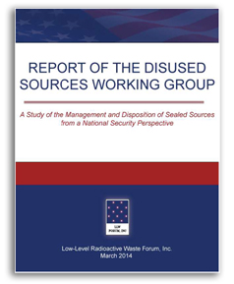
Survey Description
The DSWG and CRCPD E-34 Committee coordinated to prepare a list of questions to identify potential improvements to the States’ management of disused sealed sources.
2
CRCPD Annual Meeting St. Louis, MO May 17-21, 2015

Slide 3
Responses
42 State Radiation Control Program Directors responded representing 38 States.
Responses were given as either High, Medium or Low priority or Yes or No answers depending on the type of question.
3
CRCPD Annual Meeting St. Louis, MO May 17-21, 2015

Slide 4
CRCPD Orphan Source and SCATR Programs
These programs should continue to be funded. – 82.9% High Priority, 0% Low
The respondent distributed CRCPD literature for the 2014-2015 effort. - 71.4% Yes
My State runs its own program. – 11.9% Yes (5 States)
“Many of our licensees have taken advantage of the orphan source and SCATR programs.“
4
CRCPD Annual Meeting St. Louis, MO May 17-21, 2015

Slide 5
OSRP
OSRP should continue to be funded. – 78.6% High, 0% Low
DOE/NNSA should collect GTCC sources. – 90.5% High
DOE/NNSA should ensure compliance with State and Compact Requirements. – 90.5% High
5
CRCPD Annual Meeting St. Louis, MO May 17-21, 2015

Slide 6
DoD’s Restrictive Acceptance Policies
Has your State been affected by DoD’s more restrictive acceptance policy? - 29.3% Yes
Several directors felt strong enough about this problem to comment on it.
“More sources from past federal uses should be accepted for disposal by federal entities.”
“Our concern is that recycling facilities may no longer be incentivized to report these sources and assure proper dispositioning.“
6
CRCPD Annual Meeting St. Louis, MO May 17-21, 2015

Slide 7
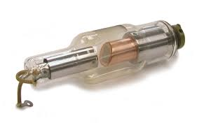
Alternative Technologies
NNSA should continue to support development of alternative technologies. – 42.1% for both High & Medium
NNSA should provide incentives to promote the use of alternative technologies. – 76.3% High or Medium, 44.7% Medium
7
CRCPD Annual Meeting St. Louis, MO May 17-21, 2015

Slide 8
Life-cycle Cost Outreach
CRCPD should receive more funding to lead the outreach effort. – 88.1% High or Medium, 52.4% Medium
My State would support this program. – 83.3% High
My State has a program. – 11.9% Yes (5)
Licensees should acknowledge in writing that they understand their responsibilities. – 45.0% Medium
8
CRCPD Annual Meeting St. Louis, MO May 17-21, 2015

Slide 9
Reuse and Recycling Programs
My State has a program to encourage reuse and recycling. – 11.9% Yes (5 States)
If there were a program my State would encourage participation. – 95.2% Yes
States and NRC should encourage reuse of sources already in licensees possession. – 90.4% High or Medium, 57.1% High
“Regardless of the security provided for the storage at a licensee, it is better to have them recycled for active use, or properly disposed.”
9
CRCPD Annual Meeting St. Louis, MO May 17-21, 2015

Slide 10
Reuse and Recycling Study
CRCPD should conduct a study on reuse and recycling opportunities. – 85.7% High or Medium, 57.1% Medium
EPA should conduct a study on reuse and recycling opportunities. – 83.3% High or Medium, 45.2% Medium
10
CRCPD Annual Meeting St. Louis, MO May 17-21, 2015

Slide 11
Source Exchange Program
CRCPD should develop a secure source exchange registry. – 90.5% High or Medium, 47.6% Medium
A federal entity should provide funding. – 90.4% High or Medium, 57.1% High
11
CRCPD Annual Meeting St. Louis, MO May 17-21, 2015

Slide 12
“Sham Recycling” Prevention
NRC should establish policies and procedures to ensure that recycling operations are not disguises for waste brokering or long term storage of disused sources that are unlikely to be recycled. – 90.5% High or Medium, 61.9% High
12
CRCPD Annual Meeting St. Louis, MO May 17-21, 2015

Slide 13
Rulemaking vs. Policymaking
My State can take the initiative on policy making. – 60.0% Yes
If a rule change is required, NRC will have to change their rules first. – 66.7% Yes
13
CRCPD Annual Meeting St. Louis, MO May 17-21, 2015

Slide 14
Fees to Encourage Disposal
NRC and States should assess these fees. – 80.0% Medium or Low, 47.5% Medium
My State has fees like this or plans to add fees. – 82.5% No (7 States Yes)
14
CRCPD Annual Meeting St. Louis, MO May 17-21, 2015

Slide 15
Financial Assurance
NRC needs to update FA rules to align with costs. – 89.5% High or Medium, 63.2% High
My State has or has plans to require additional FA. – 81.6% No (7 States Yes)
The current system for determining when FA is required is adequate. – 55.6% No
15
CRCPD Annual Meeting St. Louis, MO May 17-21, 2015

Slide 16
Financial Assurance by IAEA Category
To Encourage Timely Disposal;
NRC should require FA for all Category 1 & 2 Sources. – 78.9% High or Medium, 63.2% High
NRC should require FA for all Category 1, 2 & 3 Sources. – 68.4% Medium or Low, 36.8% Low
16
CRCPD Annual Meeting St. Louis, MO May 17-21, 2015

Slide 17
Licensing Category 3 Sources
All Category 3 sources should be SL. – 76.3% High or Medium, 42.1% High
My State requires all Category 3 sources to be SL. – 15.8% Yes (6 States)
My State requires all “GL devices” to be under SL. – 24.3% Yes (9 States)
NRC would need to put it in rule before my State can act. – 56.8% Yes
“Colorado already requires specific licensing for generally licensed devices of Category 3.5 or higher.”
17
CRCPD Annual Meeting St. Louis, MO May 17-21, 2015

Slide 18
Security of Category 3 Sources
Should the following be subject to greater security:
Category 3 sources, such as Am/Be sources. – 47.4% Medium
Licensees with Category 3 sources that exceed Category 2 when combined. – 36.8% for both High & Medium
18
CRCPD Annual Meeting St. Louis, MO May 17-21, 2015

Slide 19
Category 3 Source Tracking
All Category 3 sources should in principle be tracked by NRC. – 76.3% Medium or Low, 39.5% Medium
NRC should expand the NSTS to track Category 3 sources. – 42.1% for both Medium and Low
“I disagree that Cat 3 sources should be tracked using something like NSTS. Our licensees notify us when sources are lost or stolen, regardless of whether they are part of the NSTS.”
19
CRCPD Annual Meeting St. Louis, MO May 17-21, 2015

Slide 20
Storage Time Limits
NRC and States should put a time limit on the storage of disused sources. – 80.0% High or Medium, 47.5% High
2 Years is enough time to arrange disposal. - 66.7% Yes
My State has plans to implement storage time limits. – 15.0% Yes (6 States)
“Consideration may be necessary to allow a licensee more than two years (with a potential limit of five years)…”
20
CRCPD Annual Meeting St. Louis, MO May 17-21, 2015

Slide 21
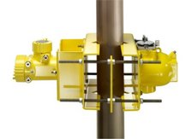
GL 2-Year Storage Rule
It should be actively enforced. - 75.0% High or Medium, 42.5% High
My State tracks GL sources in storage and actively enforces the rule. - 62.5% No
21
CRCPD Annual Meeting St. Louis, MO May 17-21, 2015

Slide 22
Manufacturers and Suppliers
Manufacturers and suppliers should dispose of sources annually that have no recycle or reuse value. - 83.3% High or Medium, 50.0% High
“Manufacturers and distributors need to be encouraged to help licensees dispose of unwanted sources.“
22
CRCPD Annual Meeting St. Louis, MO May 17-21, 2015

Slide 23
Disused Source Inspections
NRC and States should develop inspection procedures to identify disused sources in long term storage. – 83.3% High or Medium, 50.0% Medium
23
CRCPD Annual Meeting St. Louis, MO May 17-21, 2015

Slide 24
“Use Status” Field in NSTS
NRC should make this field mandatory. – 86.4% High or Medium, 48.6% Medium
My State notified licensees to start using this field. – 72.2% No
“If the NRC wants a status for each source then they should require that field to be filled before they allow the licensee to leave that page.”
24
CRCPD Annual Meeting St. Louis, MO May 17-21, 2015

Slide 25
Type B Containers
NRC and DOT should work to improve availability. – 76.3% High
NNSA should assess container availability. – 63.2% High
NNSA should assess foreign made packages to fill the shortage. – 60.5% High
NRC and DOT should expedite approval of foreign containers. – 57.9% High
25
CRCPD Annual Meeting St. Louis, MO May 17-21, 2015

Slide 26
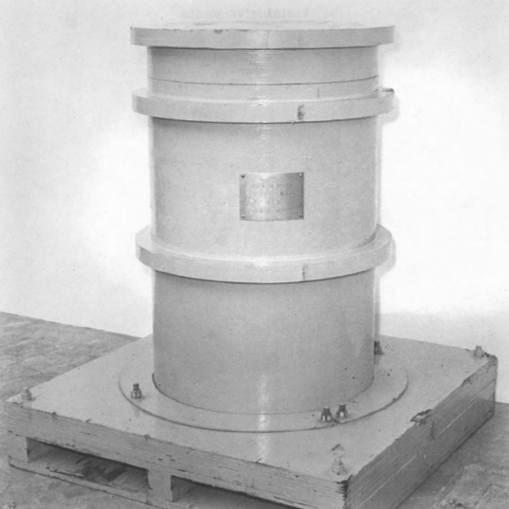
Container Expiration
DOT and NRC should develop a process that will provide licensees and States at least one year advance notice of container certificate expiration. - 60% High
26
CRCPD Annual Meeting St. Louis, MO May 17-21, 2015

Slide 27
Concentration Averaging BTP
States with disposal sites should implement the new BTP. – 56.4% Medium
27
CRCPD Annual Meeting St. Louis, MO May 17-21, 2015

Slide 28
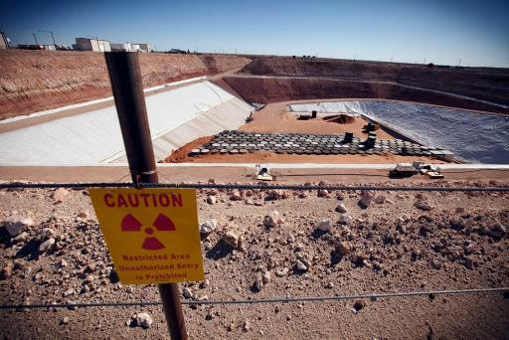
Texas Radioactive Waste Facility
The decision to allow out-of-compact waste has been important. – 94.6% Yes
My State (for those that can) will encourage licensees to send waste to the Texas Compact Facility. – 93.3% Yes
28
CRCPD Annual Meeting St. Louis, MO May 17-21, 2015

Slide 29
Foreign Source Policies
NRC should reconsider its foreign source importation policy. – 57.1% Medium
Only if the importer can guarantee reuse in the US. – 80.9% High or Medium, 45.2% Medium
“Requiring a guarantee of use for an imported source is probably futile. At least their security can be better assured here in the US. ”
293
CRCPD Annual Meeting St. Louis, MO May 17-21, 2015

Slide 30
Possible Future CRCPD/DSWG Projects
30
Consider the possibility of a CRCPD-led life-cycle cost education program.
Consider the possibility of a CRCPD-led reuse/recycle and source exchange program.
Survey the Directors to rank priorities more precisely.
Survey other stakeholder groups.
30
CRCPD Annual Meeting St. Louis, MO May 17-21, 2015

Slide 31
For More Information
LLW Forum (754) 779-7551 LLWForumInc@aol.com
CRCPD (502) 227-4543 CRCPD.org
Ray Fleming at (512) 834-6688 x2206 Ray.fleming@dshs.state.tx.us
For More Updates Visit
www.disusedsources.org
31
CRCPD Annual Meeting St. Louis, MO May 17-21, 2015

